Slide 1


P R O J E C T E X O S E E K E R
MAHIR GHOTIA

Slide 2
PROJECT CHALLENGE
GOAL
DEVELOP ML MODEL TO IDENTIFY EXOPLANETS FROM SPACE MISSION DATA
FASTER AND ACCURATELY
OPPORTUNITY
LEVERAGE AI & ML TO ANALYZE HUGE DATASETS
IMPACT
ENHANCE THE SPEED AND ACCURACY OF EXOPLANET DISCOVERY, SUPPORTING FUTURE SPACE
EXPLORATION AND RESEARCH.
CONTEXT
THOUSANDS OF
EXOPLANETS FOUND
MANUALLY

Slide 3

EXO-SEEKER OVERVIEW
AI-POWERED EXOPLANET
DETECTION & VISUALIZATION
INTERACTIVE WEB APP TO DISCOVER NEW EXOPLANETS
BUILT WITH NASA’S
EXOPLANET ARCHIVE (KOI DATASET) VIA THE TAP API
TRAINS THE AI MODEL TO DETECT CONFIRMED PLANETS TO FALSE POSITIVES
EXOPLANET DETECTION --
FASTER, TRANSPARENT, AND ACCESSIBLE.

Slide 4
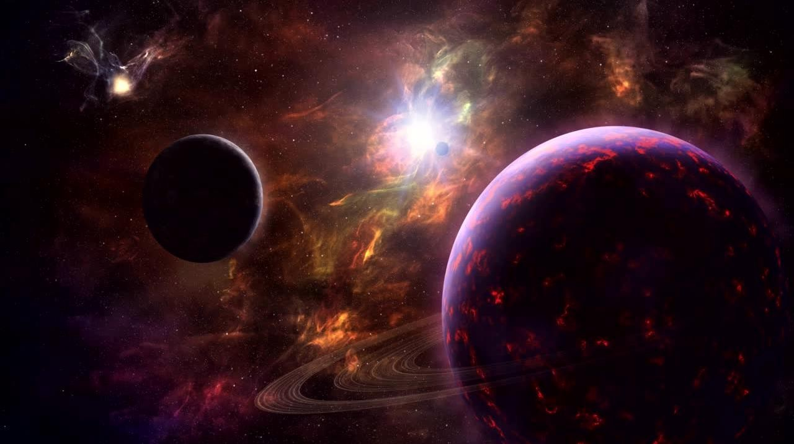
USERS IMPACT
ALLOWS USERS TO UPLOAD THEIR OWN LIGHT-CURVE DATA TO PERFORM TRANSIT SEARCHES
PROVIDES AN INTUITIVE DASHBOARD WITH 3D ORBITAL VIEWS AND REAL-TIME DATA INSIGHTS.

Slide 5
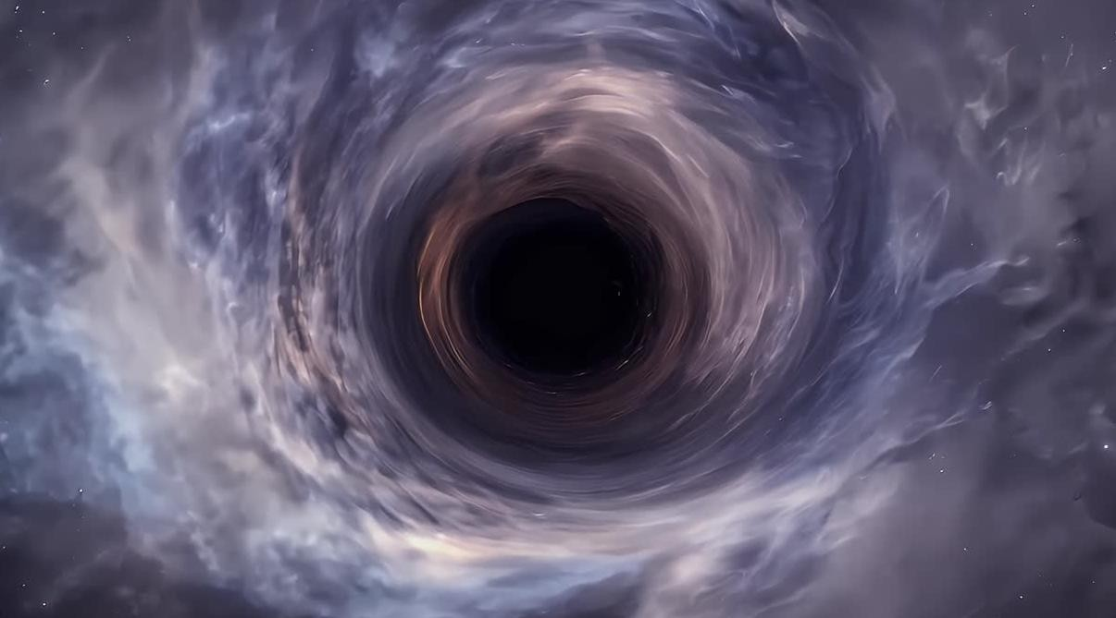
HOW IT WORKS?
FETCH KOI DATA VIA TAP API
TRAIN ML MODEL (HIST GRADIENT BOOSTING CLASSIFIER) PREDICT + VISUALIZE RESULTS IN STREAMLIT UI
RUN BLS TRANSIT SEARCH ON UPLOADS

Slide 6
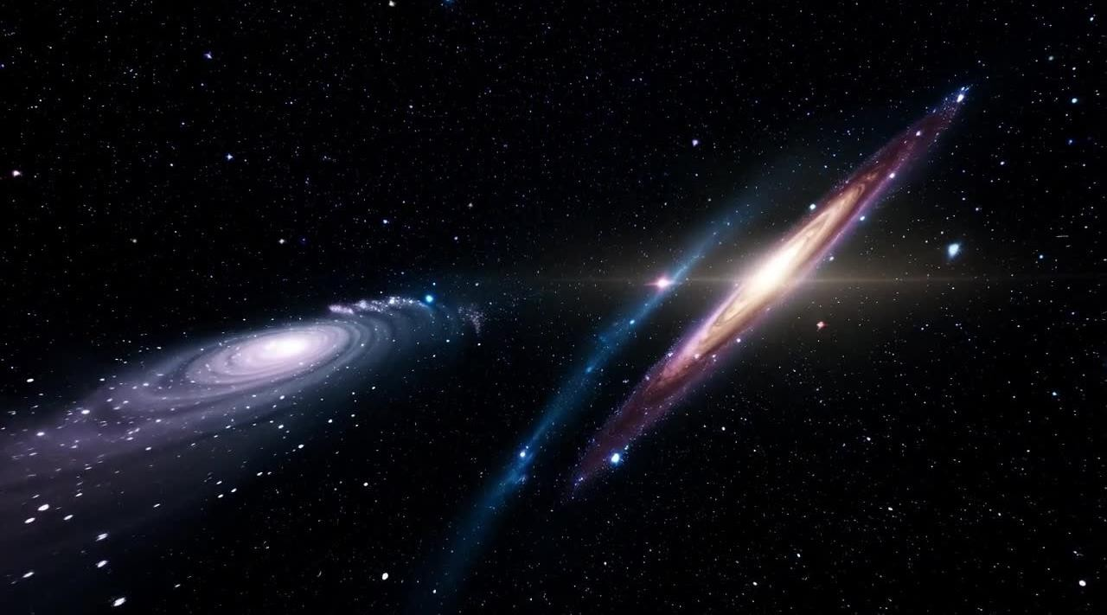
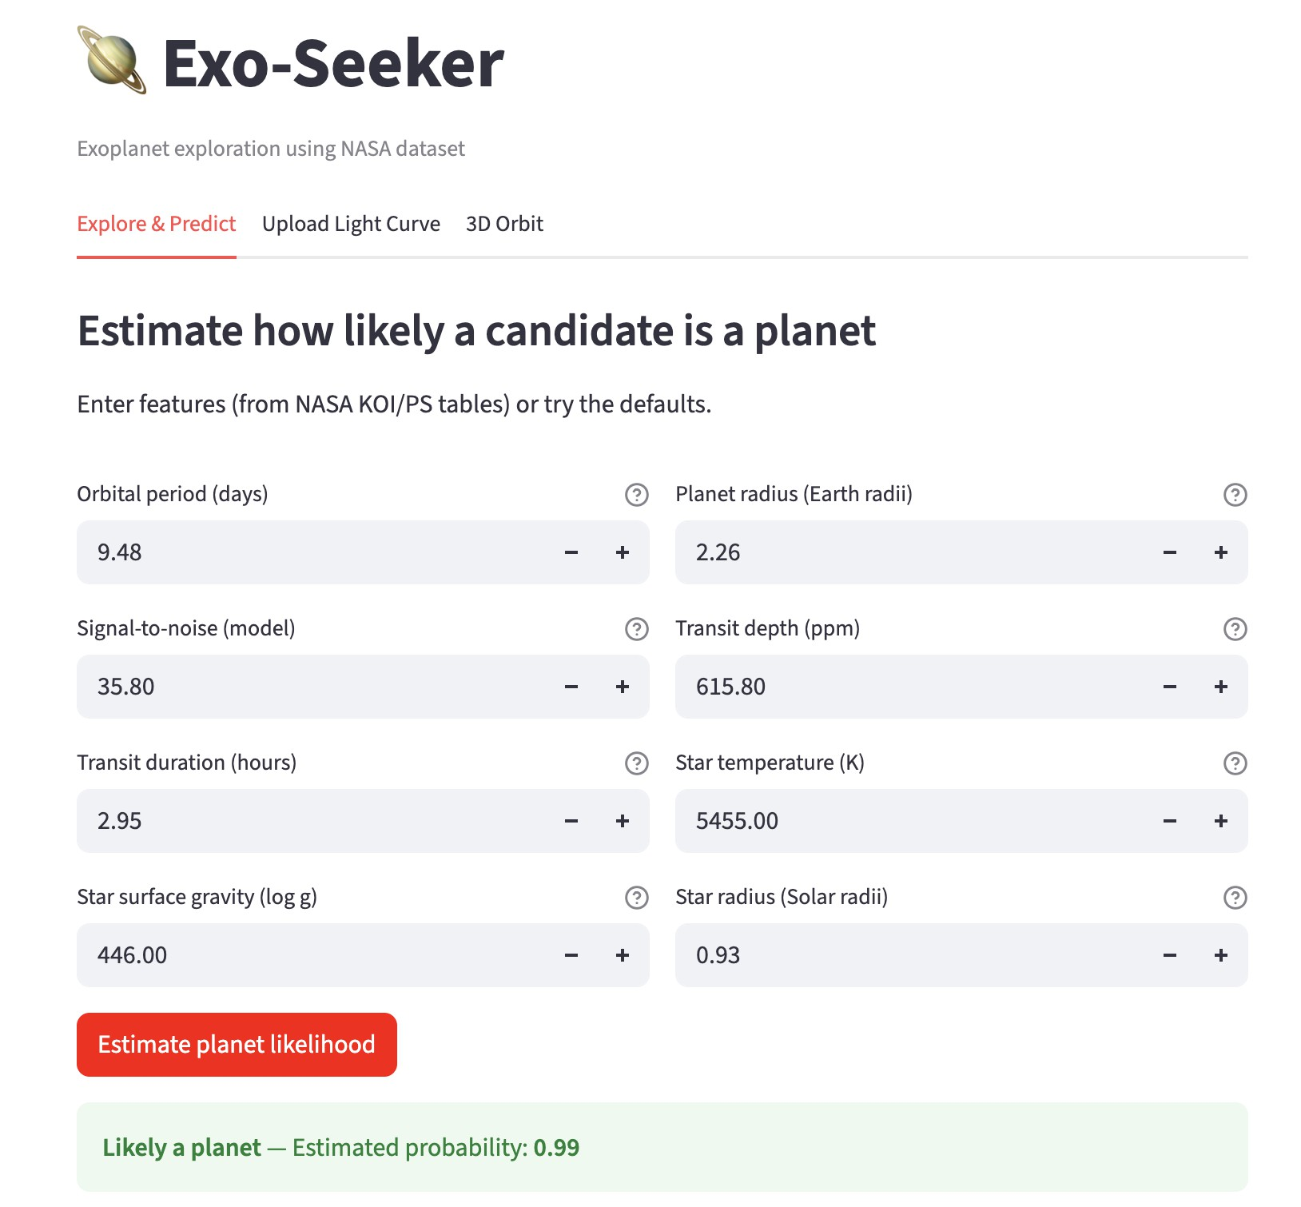
PROJECT IMPACT
AUTOMATES PLANET DETECTION
- SAVES RESEARCH TIME
MAKES NASA DATA INTERACTIVE AND PUBLIC
ENCOURAGES CITIZEN SCIENCE &
STEM ENGAGEMENT
TURNS COMPLEX DATA INTO
BEAUTIFUL VISUAL
TECH STACK
LANGUAGES: PYTHON, STREAMLIT, SCIKIT LEARN, ASTROPY, PLOTLY, NUMPY,
PANDAS
LINk: HTTPs://ExOsEEkERs-BY-
MAHIRGHOTIA.sTREAMLIT.APP/
DEPLOYMENT: STREAMLIT COMMUNITY CLOUD DATA SOURCE: NASA
EXOPLANET ARCHIVE (TAP)

Slide 7

VISION FOR THE FUTURE
ADD DEEP-LEARNING TRANSIT MODELS
INTEGRATE TESS & JWST DATASETS
PUBLIC API FOR REAL-TIME CLASSIFICATION
EXO-SEEKER — DISCOVER NEW WORLDS

Slide 8
Thank you

